Slide 1

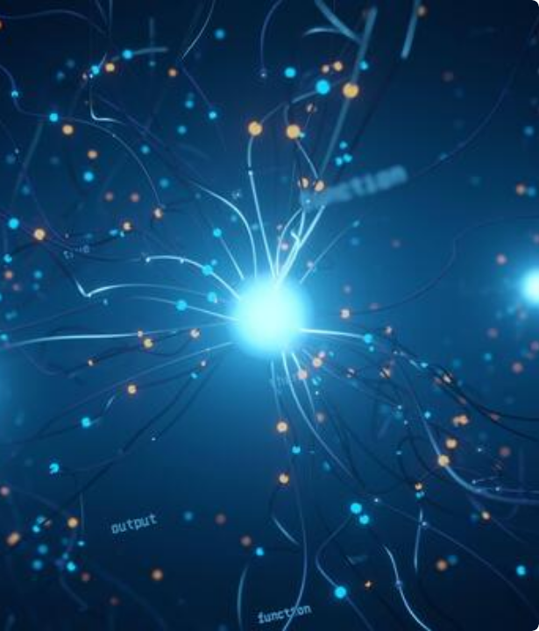
Building Agentic AI Systems
A Developer's Guide to LangChain, LangGraph, & Prompt Engineering.

Slide 2
Part 1: The Rise of Agentic AI
Why we are moving from simple chatbots to autonomous agents.

Slide 3


What is an AI Agent?
What is an Agent?
Why Agentic Systems?
An LLM-powered system that can reason, plan, and act to achieve a goal. It combines:
To move from passive text generation to active task automation. Agents provide:
•
A "Brain": The Large Language Model (e.g., GPT-4).
•
Autonomy: Act without constant human intervention.
•
Tools: Capabilities like APIs, code execution, or database queries.
•
Pro-activity: Take initiative to solve problems.
•
Complex Reasoning: Break down multi-step tasks and execute them.
•
Memory: Short-term or long-term state to track its work.

Slide 4
The Evolution of LLM Applications
2. RAG
4. Multi-Agent
Input → Retrieve Docs → LLM + Docs → Output. Knowledge-augmented.
Goal → Orchestrator → [Agent 1 ↔ Agent 2] → Final Output. Collaborative.
1. Chatbot
3. Agent
Input → LLM → Output.
Reactive and stateless.
Input → LLM(Thought) → Tool → LLM(Observe) → Output. Basic reasoning loop.

Slide 5






Key Agentic Design Patterns
ReAct (Reason + Act)
Tool Use
Multi-Agent Systems
The fundamental loop: The agent Thinks (reasons), Acts (uses a tool), and Observes (gets the result) to decide the next step.
Giving the agent capabilities beyond text generation, such as run_code, search_api, or get_weather, to interact with the real world.
Using specialized agents that collaborate. For example, a "Planner" agent tells a "Coder" agent what to build and a "Tester" agent to verify it.

Slide 6


The Orchestration Challenge
LangChain (LCEL)
LangGraph
•
What it is: A toolkit for composing components.
•
What it is: A library for building stateful, multi-actor applications.
•
Best for: Directed Acyclic Graphs (DAGs).
•
Analogy: A linear "assembly line."
•
Best for: Cyclic Graphs (loops).
•
Use Case: RAG, simple tool use, prompt chains where the path is fixed.
•
Analogy: A "state machine" or "control room."
•
Use Case: True autonomous agents, self-correction, human-in-the-loop, multi-agent systems.

Slide 7
Part 2: LangChain & LangGraph
The building blocks of your LLM application.

Slide 8
Core LangChain Components
Models: The interface to the "brain" (e.g., ChatOpenAI, Anthropic).
Chains (LCEL): The "syntax" for piping components together using the | (pipe) operator.
Tools & Retrievers: What the agent can do. (e.g., search, run code, query a vector database).
Memory: Gives the agent a short-term or long-term memory to persist state.
Setup: pip install langchain openai langgraph & set OPENAI_API_KEY.

Slide 9
Conceptual Difference: Chains vs. Agents
Feature | Chains (LangChain LCEL) | Agents (LangGraph)
Execution Path | Deterministic (Fixed, defined by developer) | Non-deterministic (LLM decides next step)
Graph Type | DAG (Directed Acyclic Graph) - Linear flow | Cyclic Graph (Allows loops, retries, jumps)
State | Stateless (or simple pass-through Memory) | Explicit, Central State Object that is modified
Use Case | RAG, Summarization, Q&A | Autonomous tasks, Self-correction, Multi-agent systems

Slide 10
Part 3: Prompt Engineering
Controlling the "brain" of your agent.

Slide 11


Prompting Techniques & Tuning
Prompting Techniques
Key Parameters
•
Prompt Templates: Reusable, parameterized structures (e.g., Human: {question}).
•
Temperature: Controls creativity. (0.0 = Deterministic, 1.0 = Creative).
•
Few-Shot Prompting: Providing 2-3 examples of "good" inputs/outputs in the prompt.
•
Max Tokens: Controls output length, cost, and speed.
•
Chain Type (for RAG): Defines how to handle large contexts (e.g., stuff, map_reduce).
•
Context Management (RAG): "Stuffing" relevant documents into the context window.

Slide 12
Questions?
Thank You.

Slide 13

Image Sources
https://static.vecteezy.com/system/resources/thumbnails/066/413/852/small_2x/futuristic-ai-brain-with-glowing-neural-network-lines-and-digital-data-nodes-on-a-dark-blue-background-video.jpg
Source: www.vecteezy.com

